Slide 1

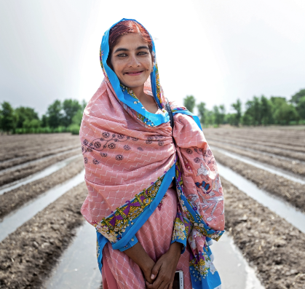
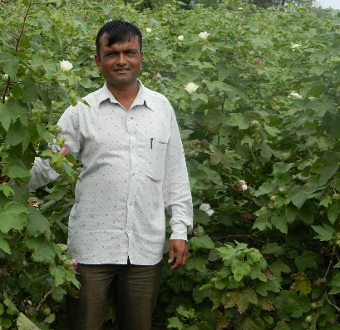
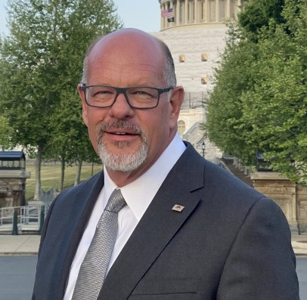
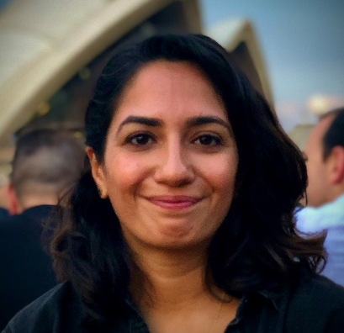

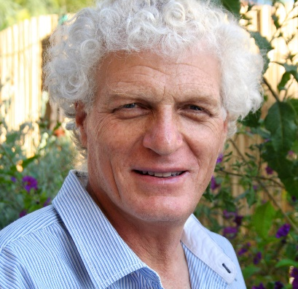
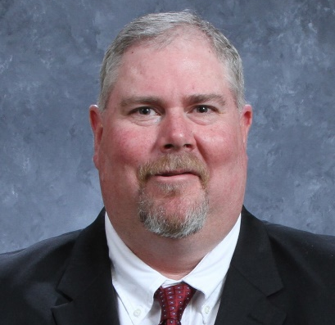
Opportunities and Challenges at Farm-level
Plenary
Thursday 22 June
With Speakers:
Facilitator:
Almas Parveen
Farmer & Project Officer, REEDS
Rasikbhai Danabhai Poriya
Farmer, Ambuja Cement Foundation
Steve Olson
Producer, ​Cindy Olson Farms Partnership
Amna Bajwa
Programme Coordinator,
Better Cotton
Jonathan Spenser
Project Officer, Israel Cotton Board
Todd Straley
Managing​ Partner, Quaterway Cotton Growers

Slide 2
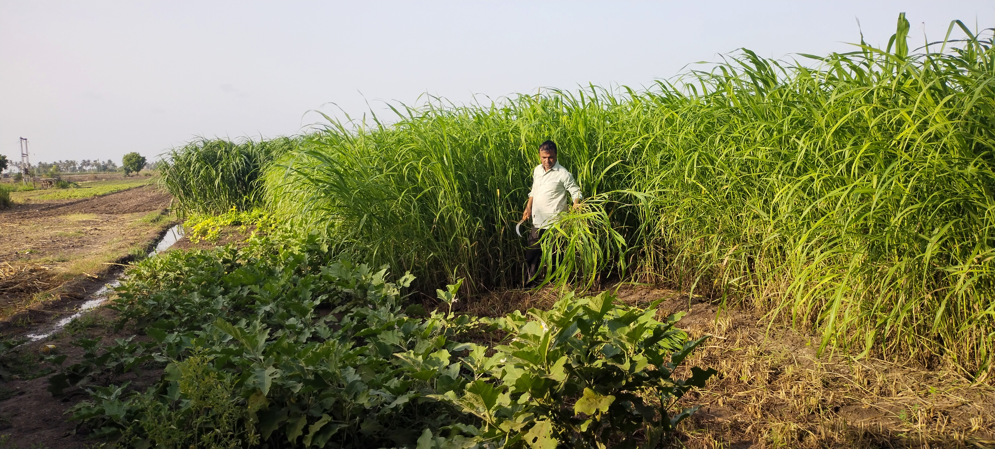
Notes:
Rasikbhai

Slide 3
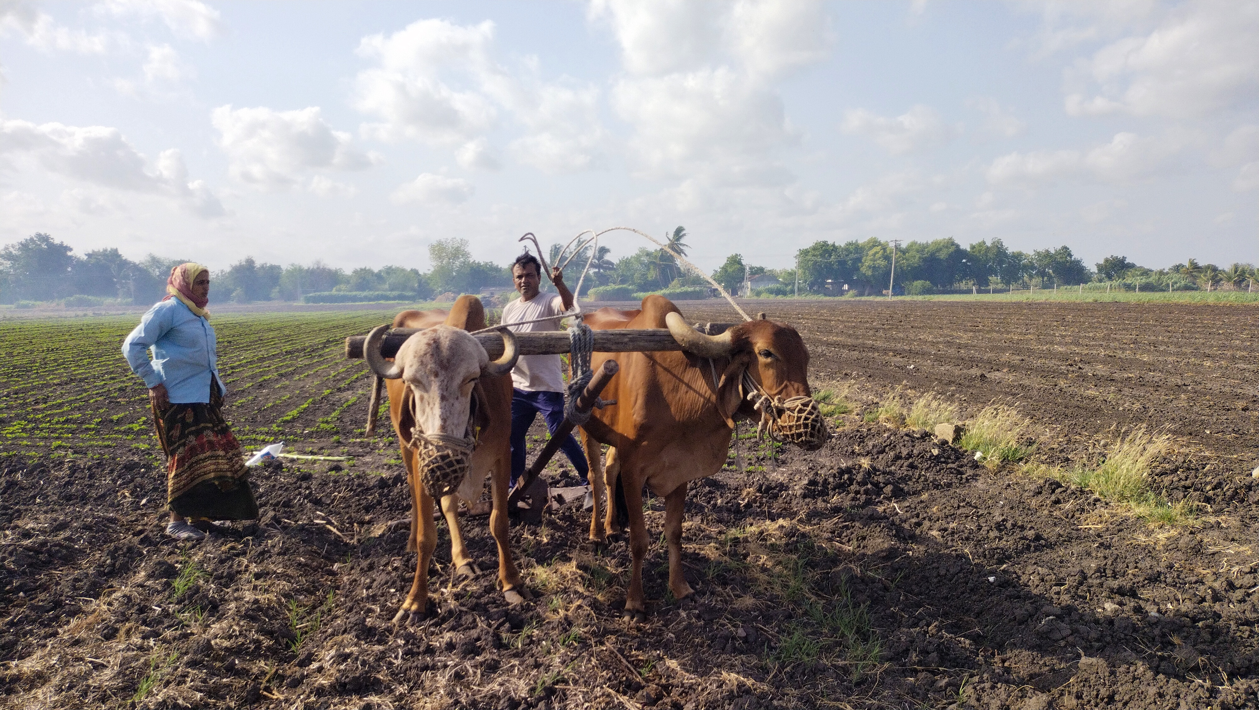
Notes:
Rasikbhai

Slide 4
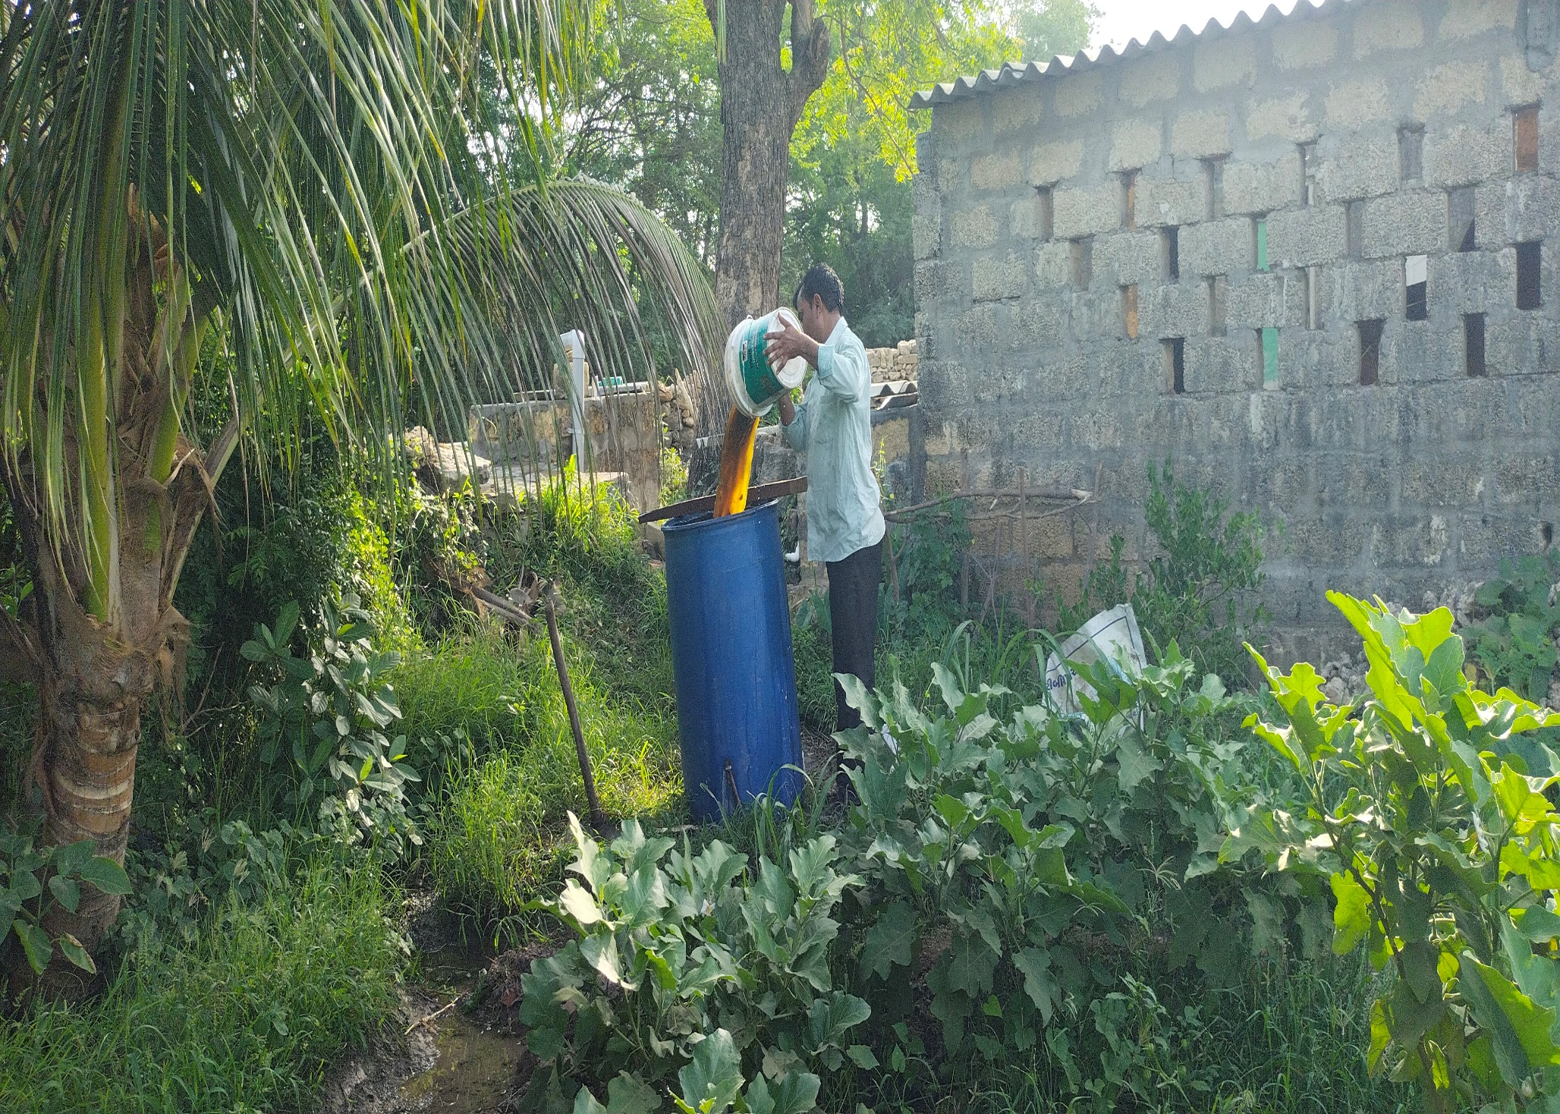
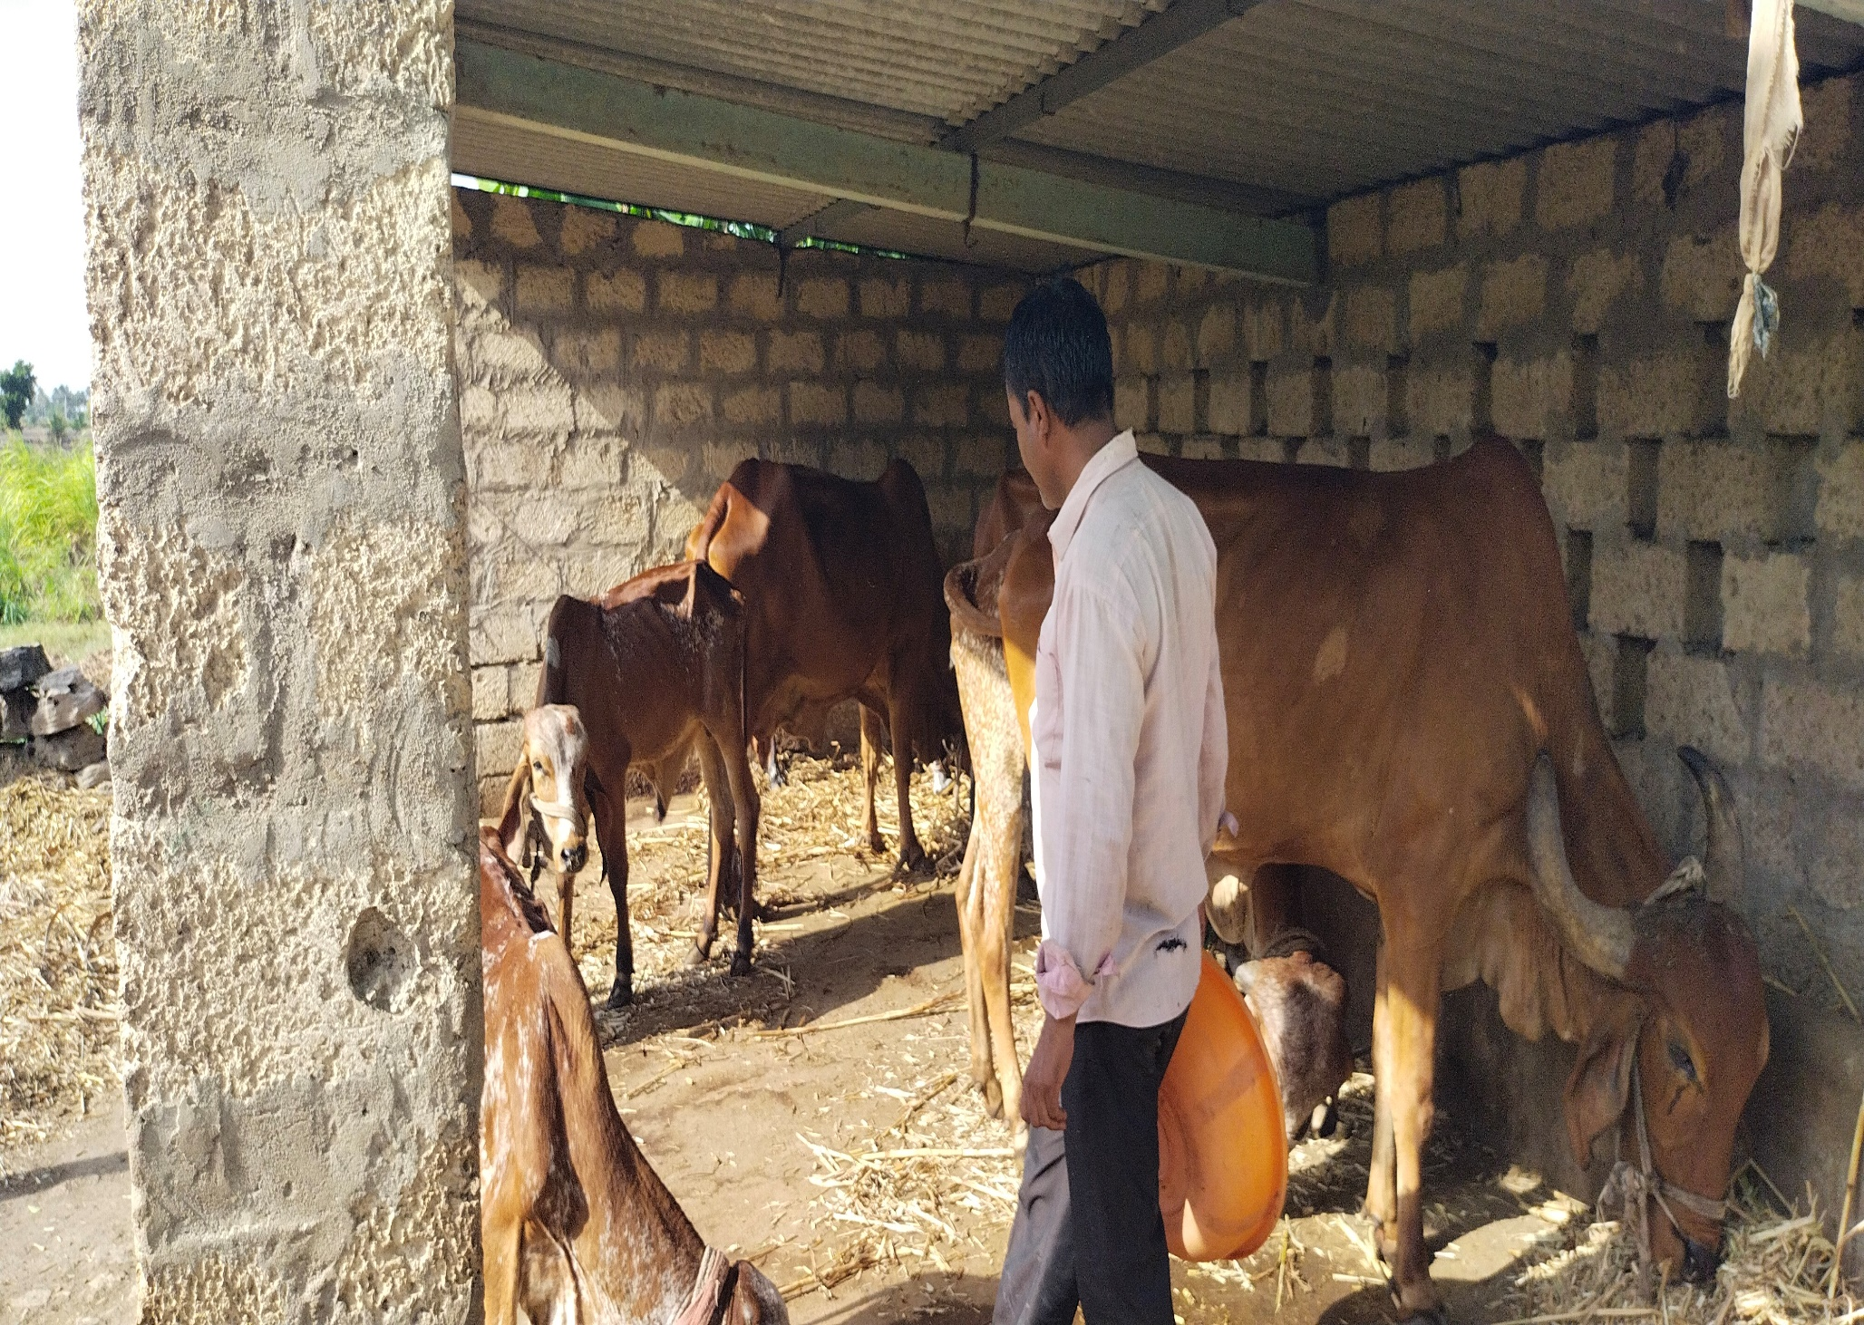
Notes:
Rasikbhai

Slide 5
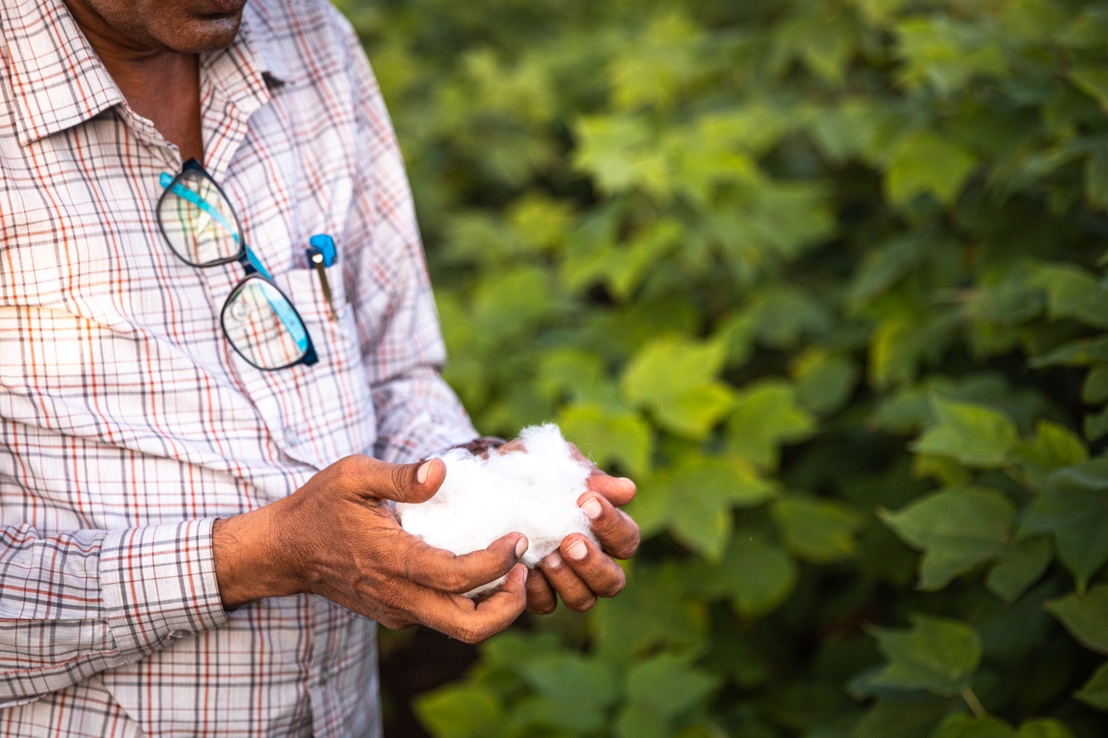


Slide 6
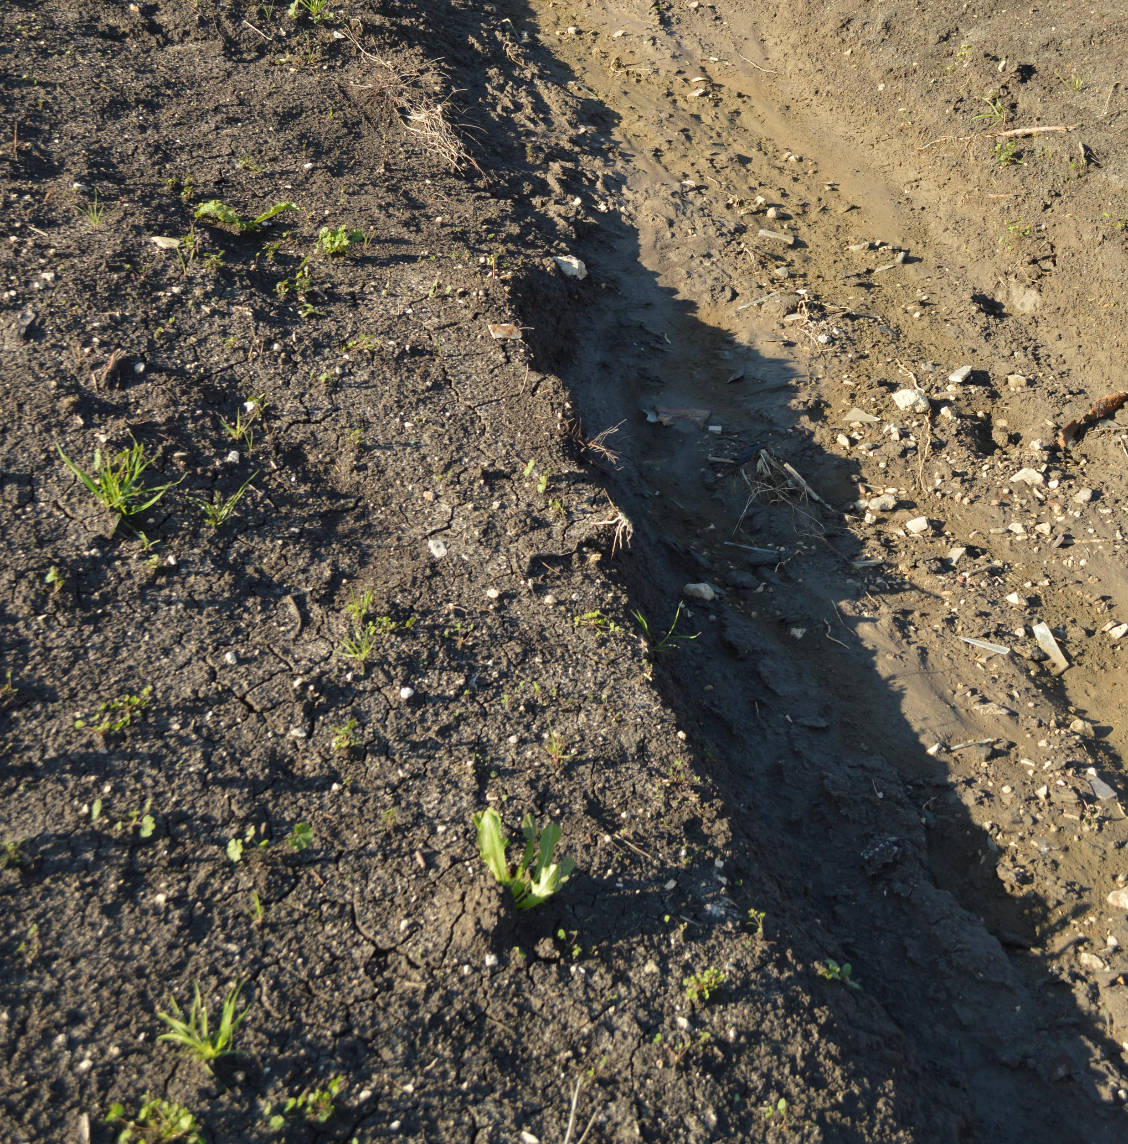
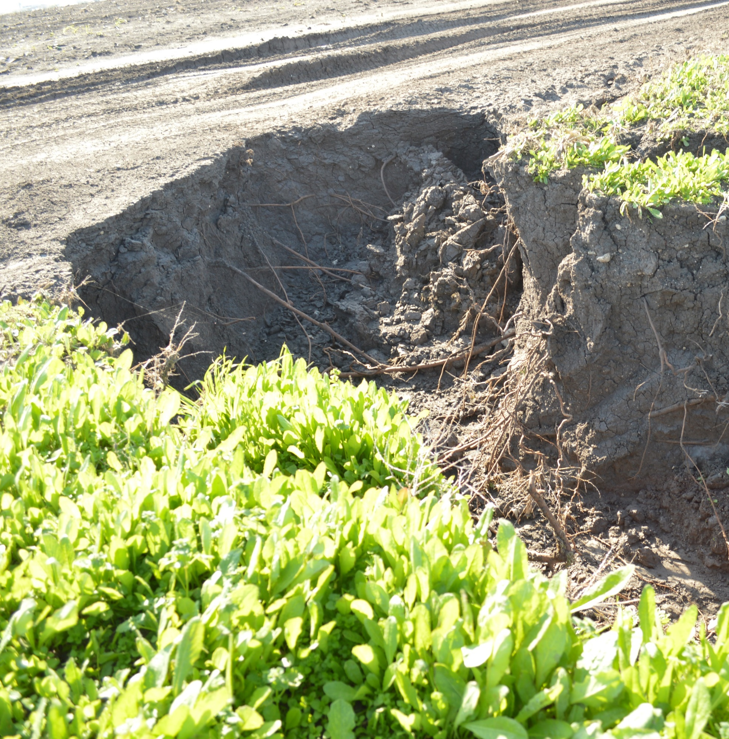
Notes:
Jonathan

Slide 7
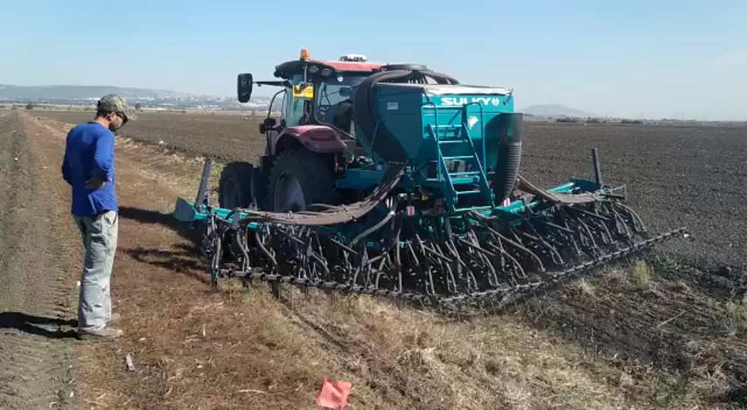
Notes:
Jonathan

Slide 8
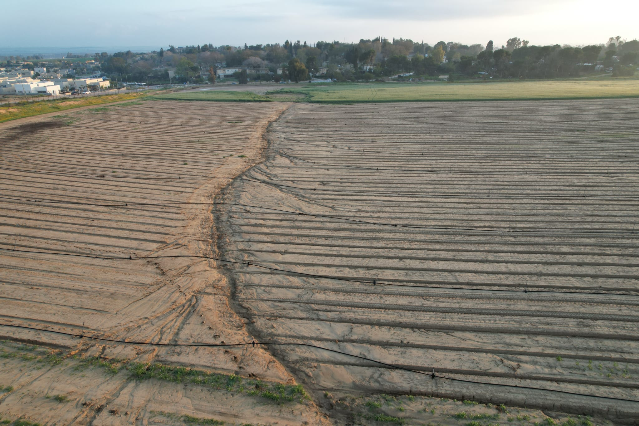
Notes:
Jonathan

Slide 9
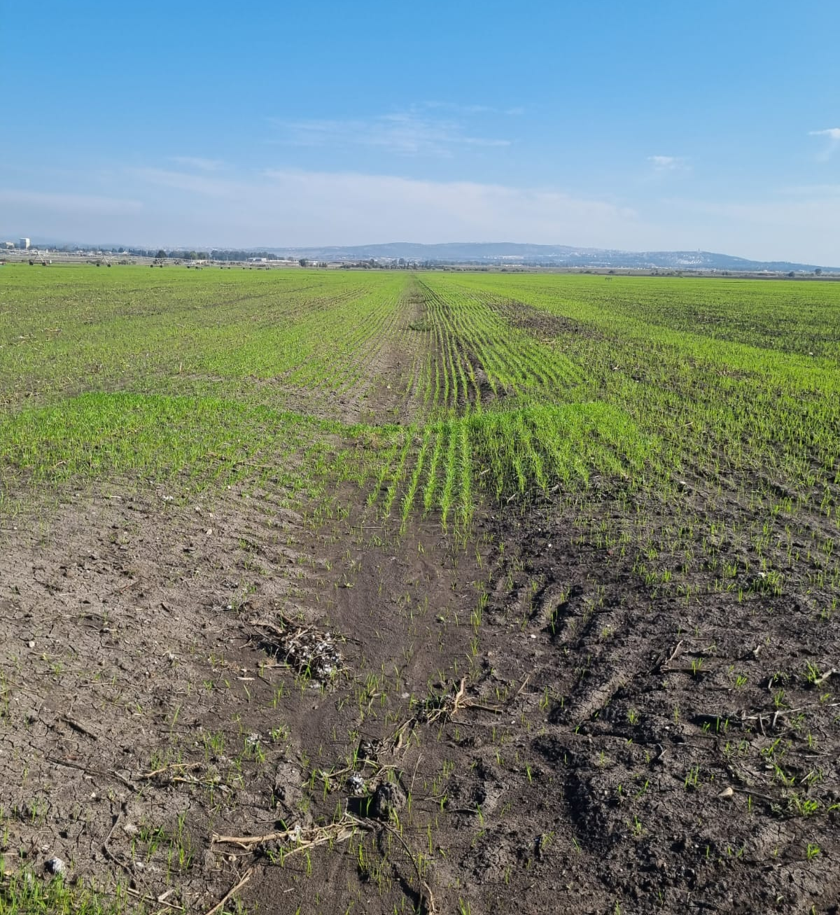

Slide 10
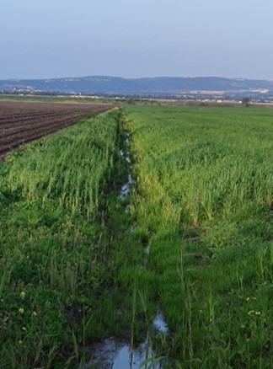
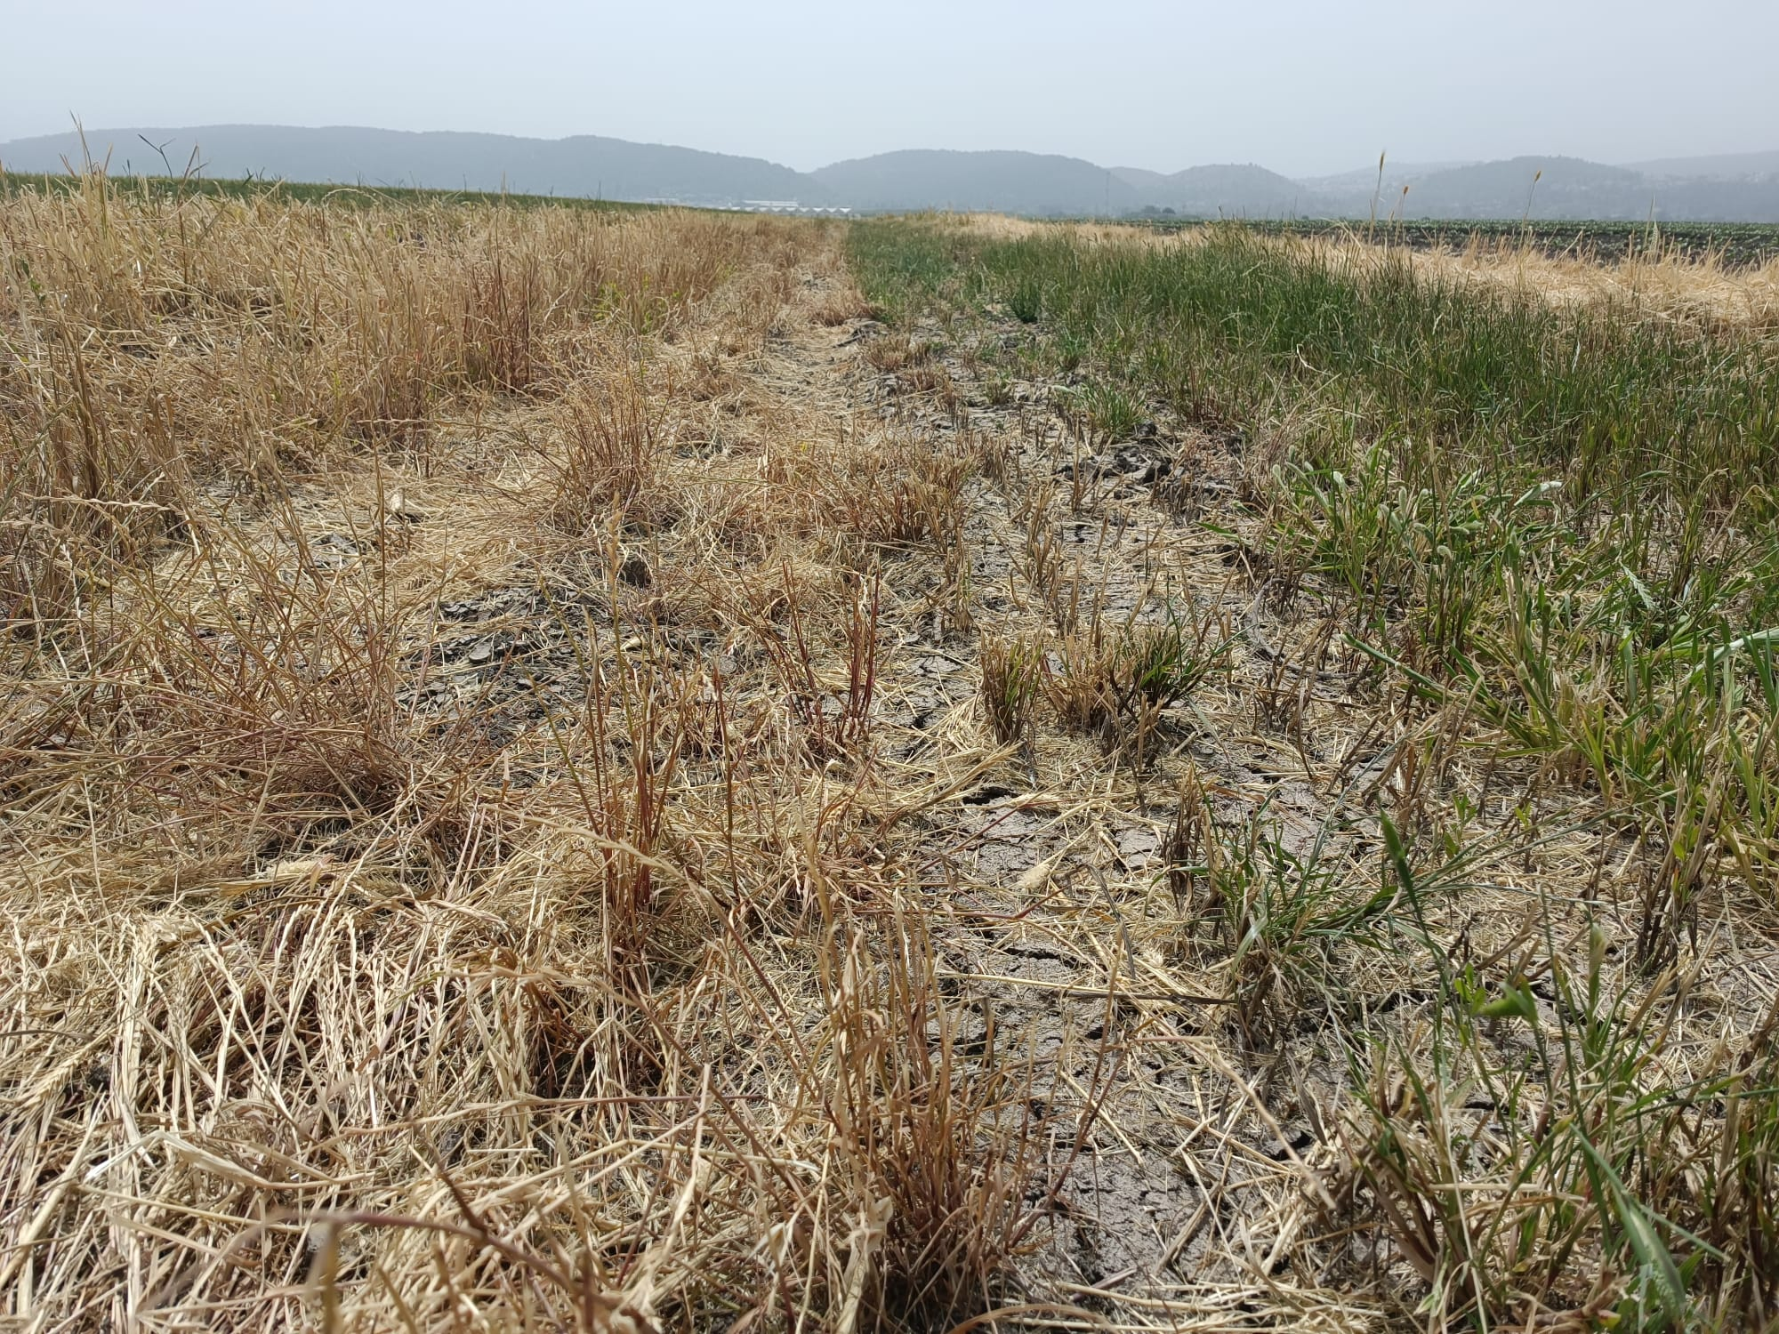
Notes:
Jonathan

Slide 11
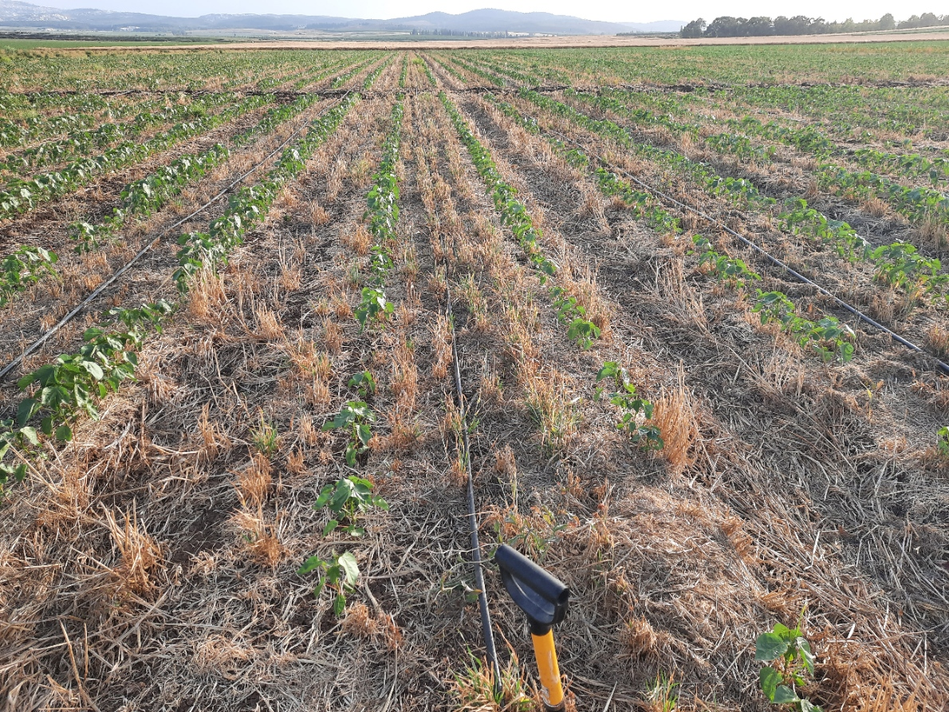
Notes:
Jonathan

Slide 12
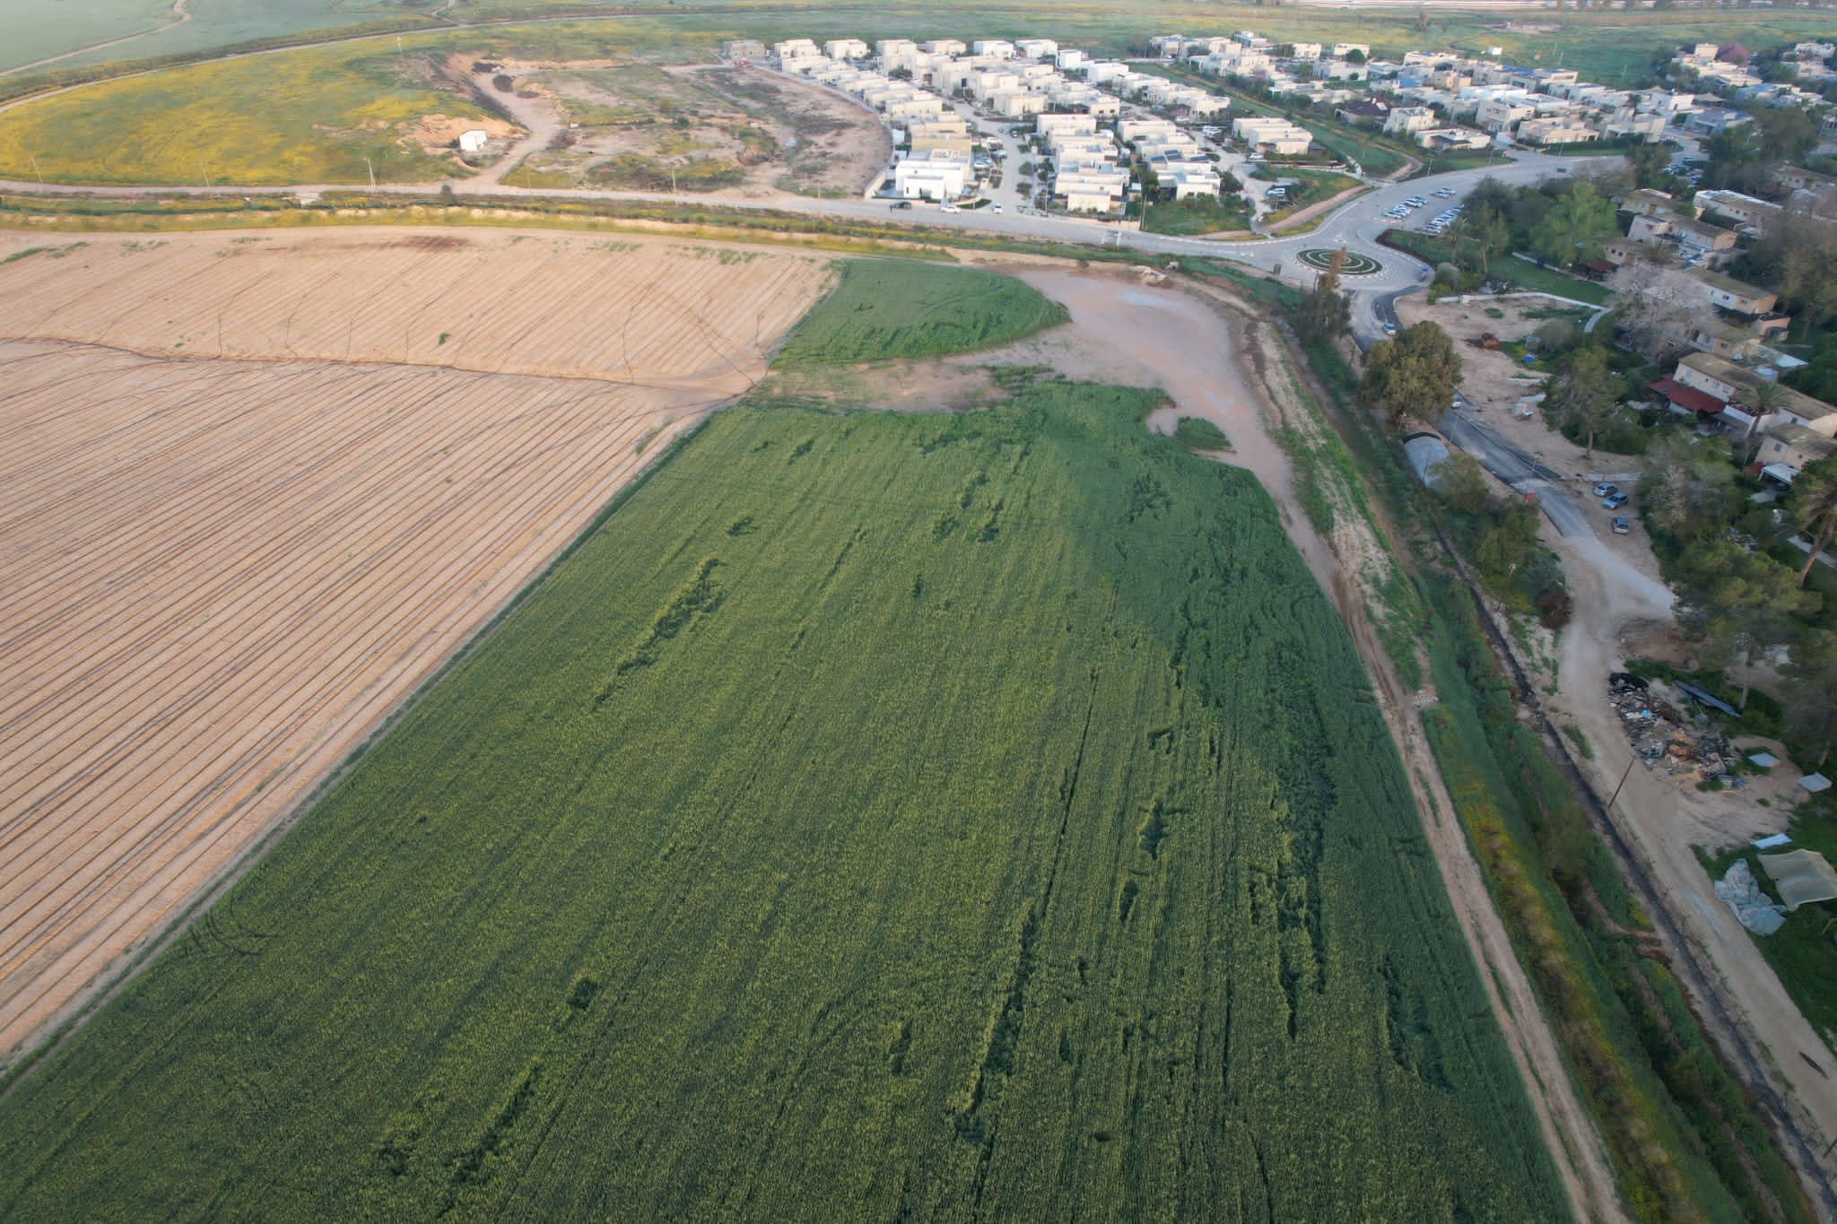
Notes:
Jonathan

