Slide 1




Work day of Julia Alafo
Mozambique – 2023 | All rights reserved.

Slide 2
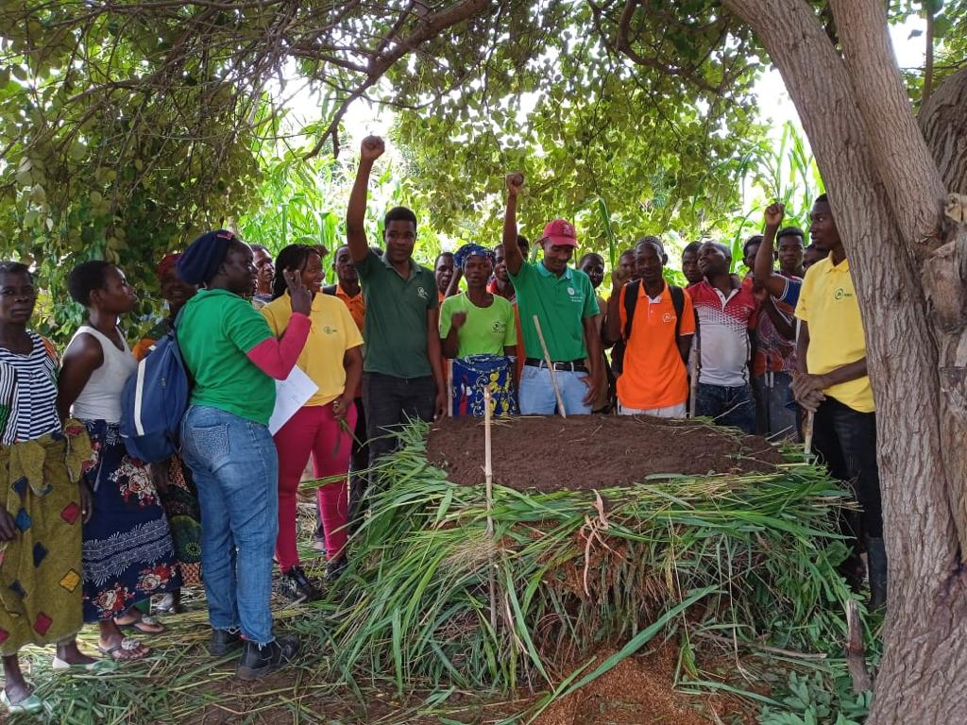
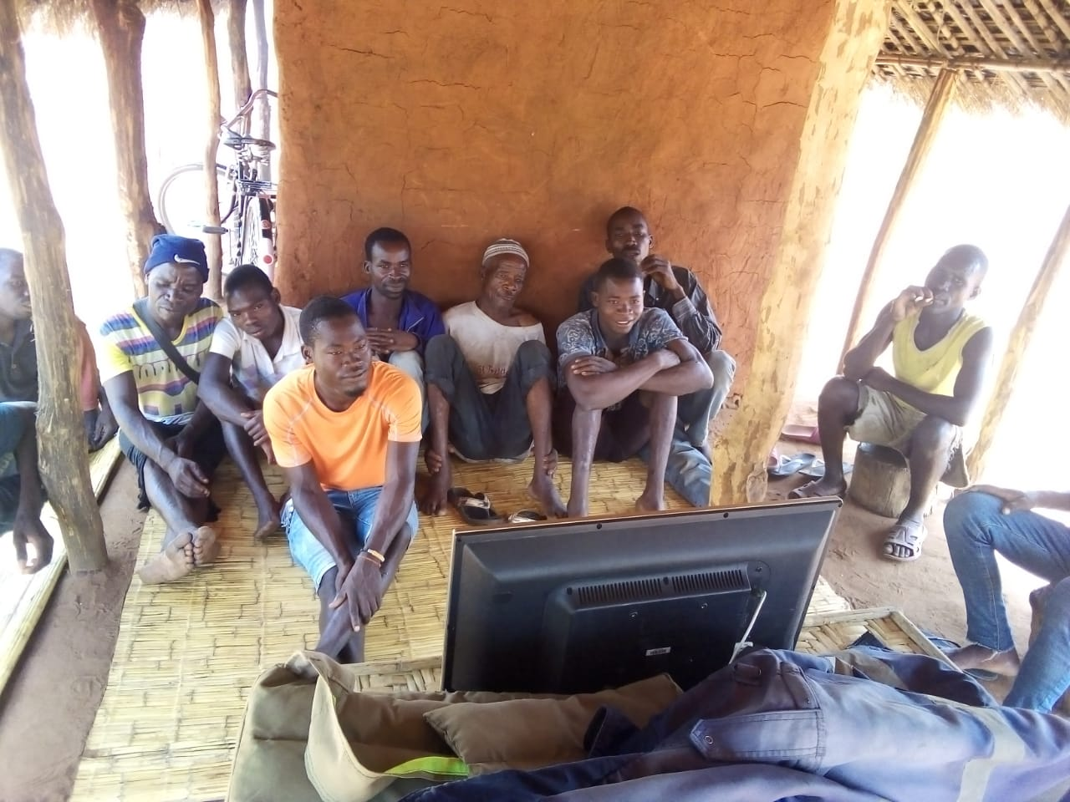
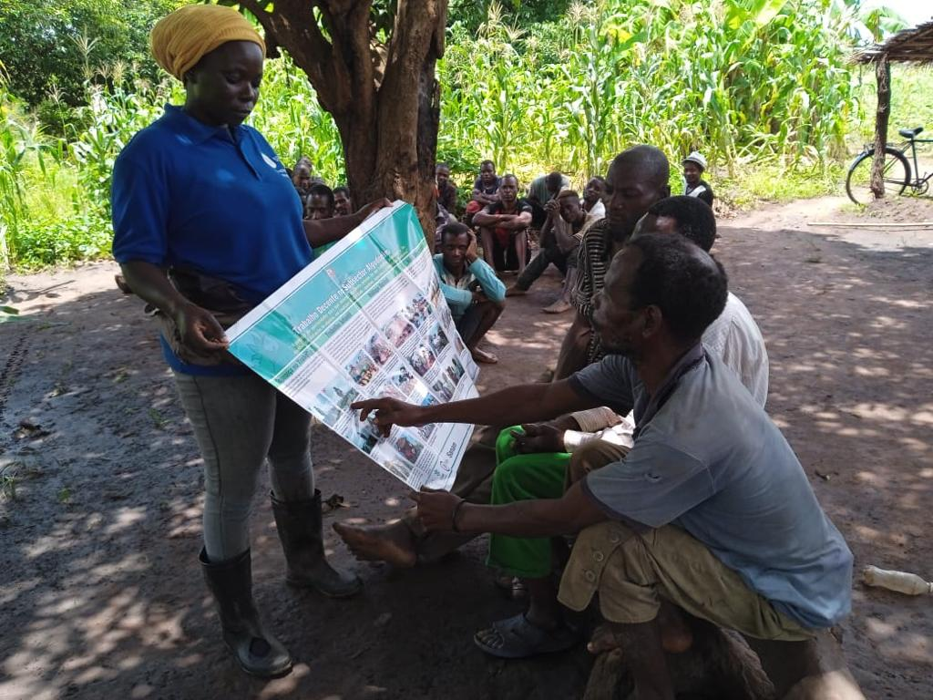

COTTON - Sociedade Algodoeira do Niassa JFS, SA
Trainings
Training of small group of farmers in each community;
Use of local made videos translated in local language, Picture blocks, Posters and Practical demonstrations.

Slide 3
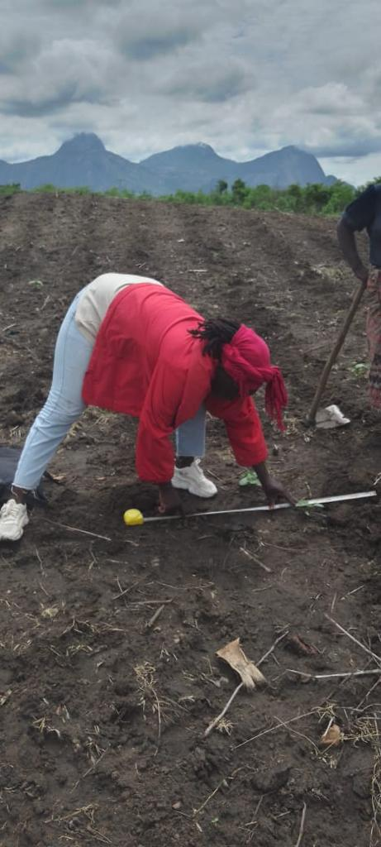
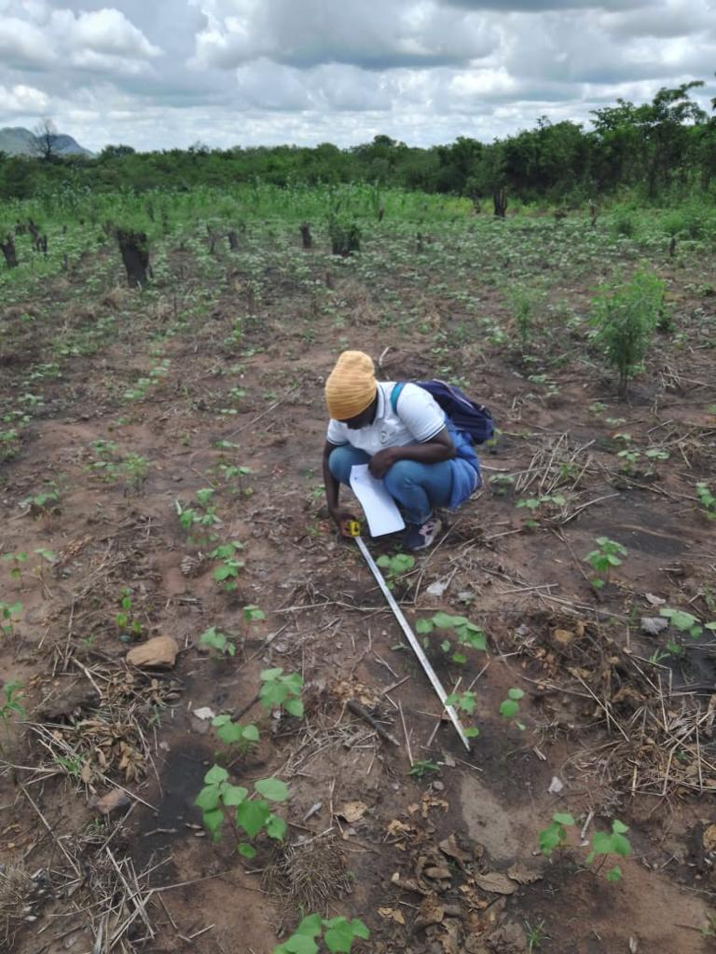
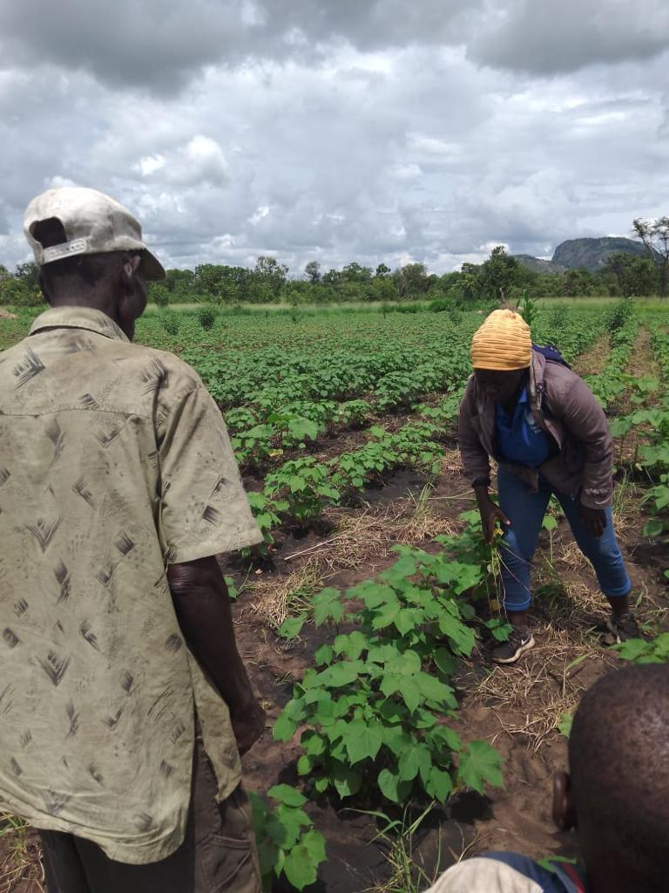
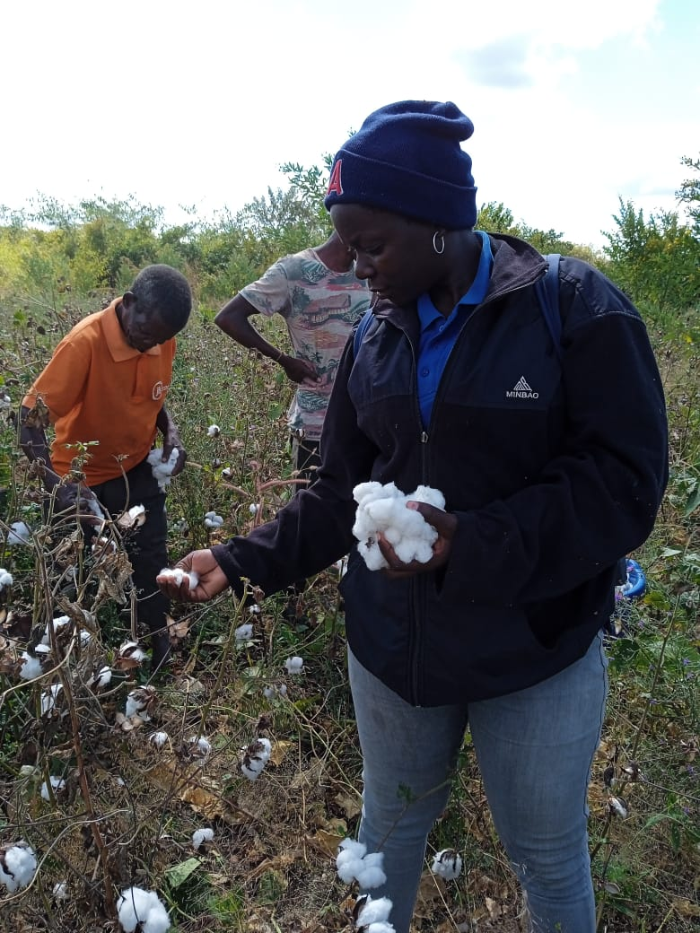
COTTON - Sociedade Algodoeira do Niassa JFS, SA
Technical assistance
Farmers assisted using 2 bases:
    S2i randomly select the farmer per day;
    Farmers asking for assistance through call center;

Slide 4
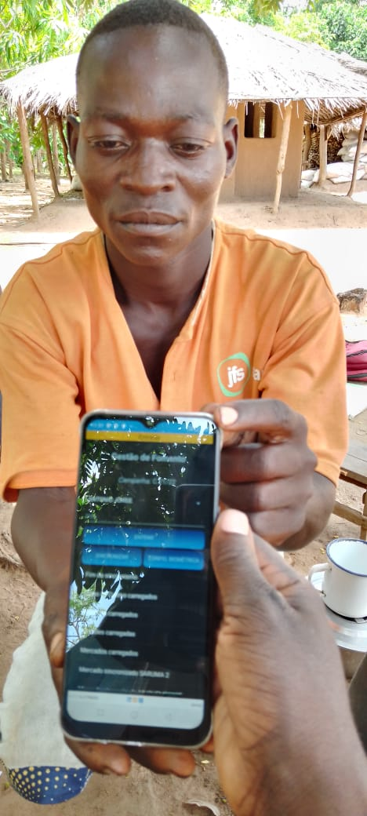
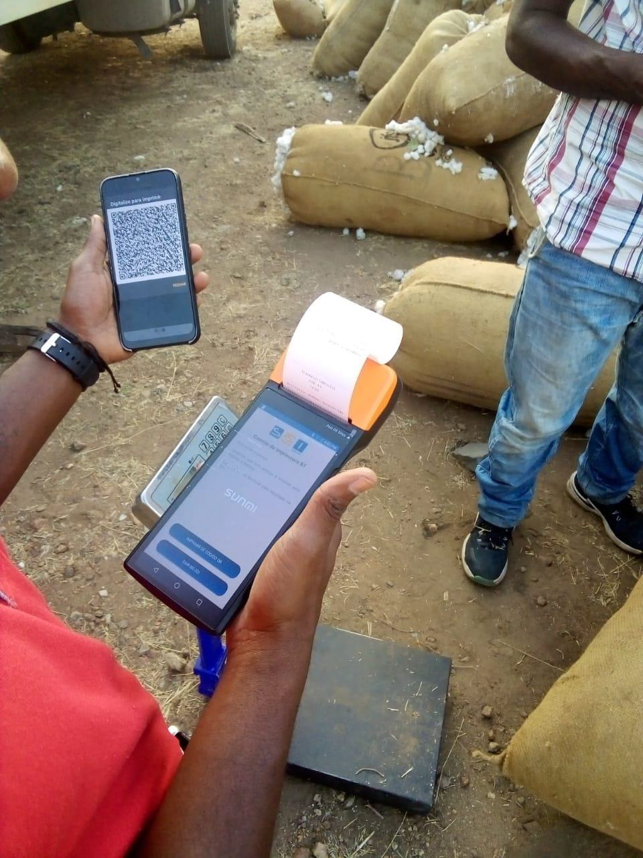
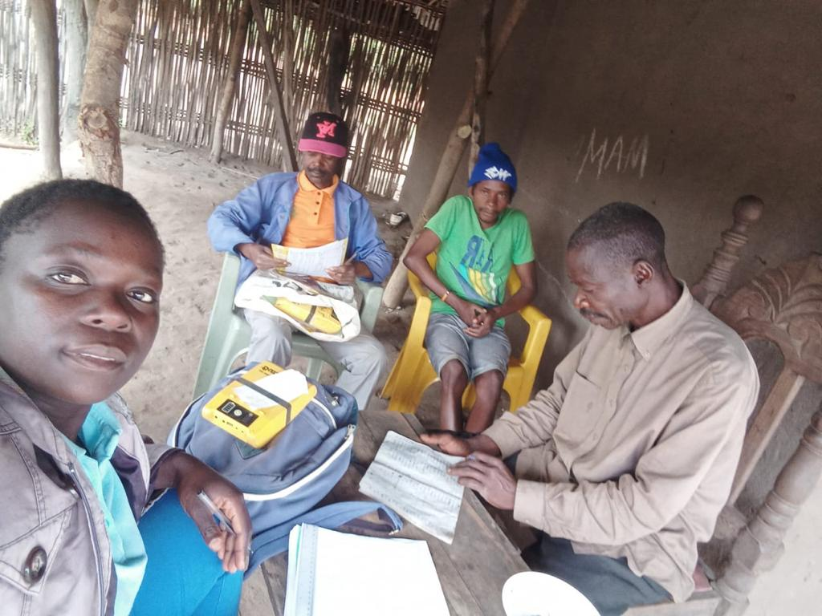
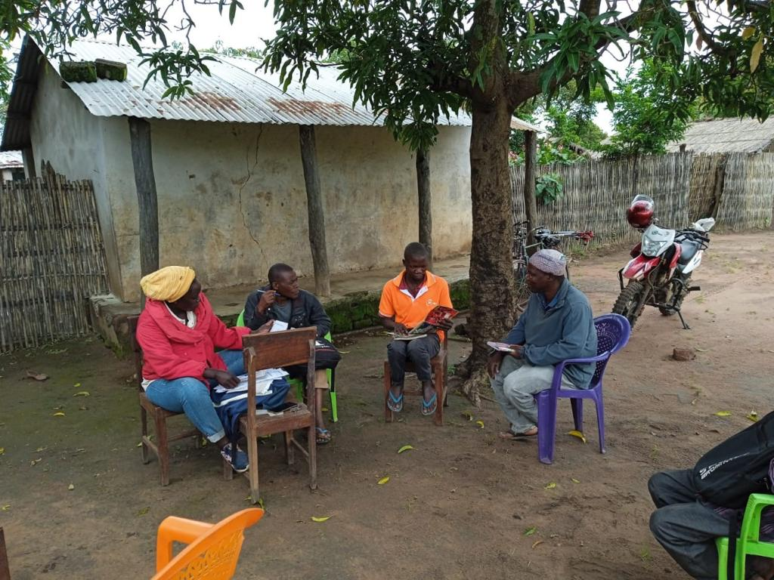
COTTON - Sociedade Algodoeira do Niassa JFS, SA
Collect farmer’s data (S2i)
Biometrical data registration (inputs);
Registration of farmers inputs and returns;
Socioeconomic information.

Slide 5
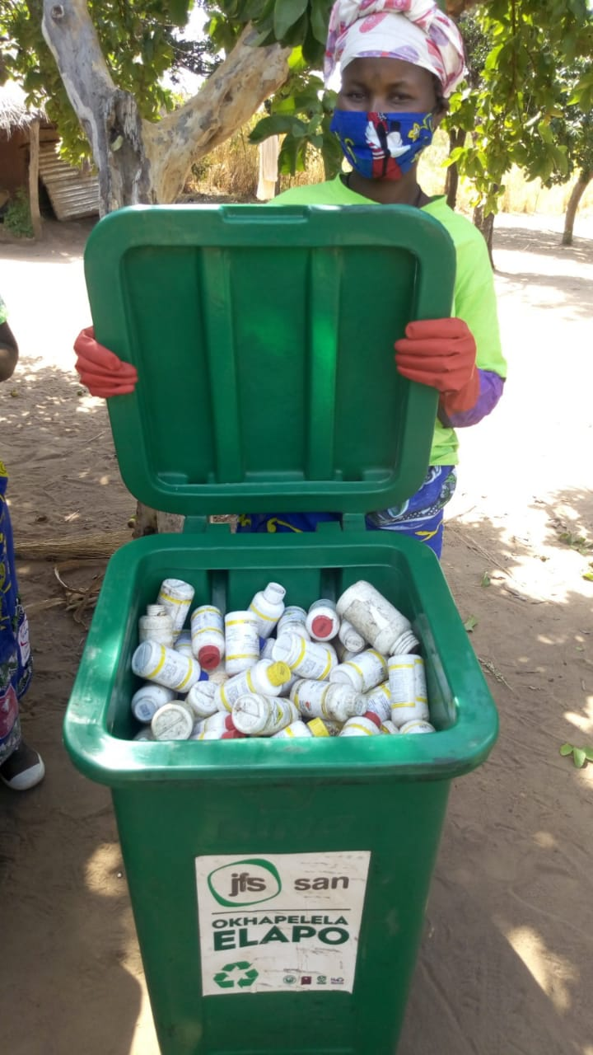
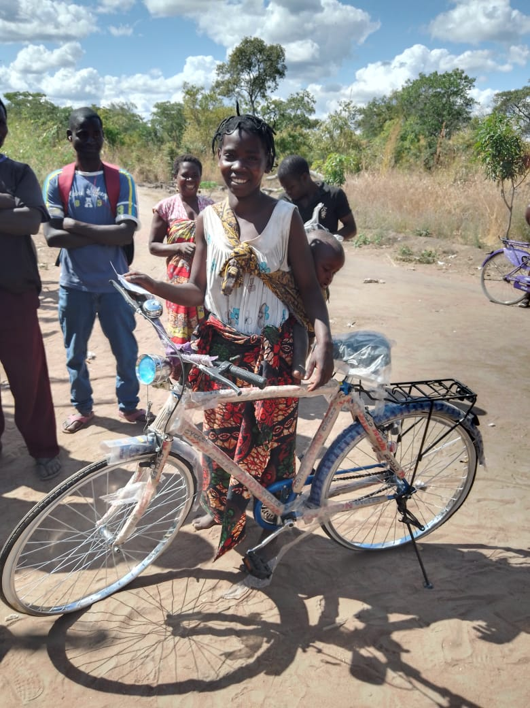
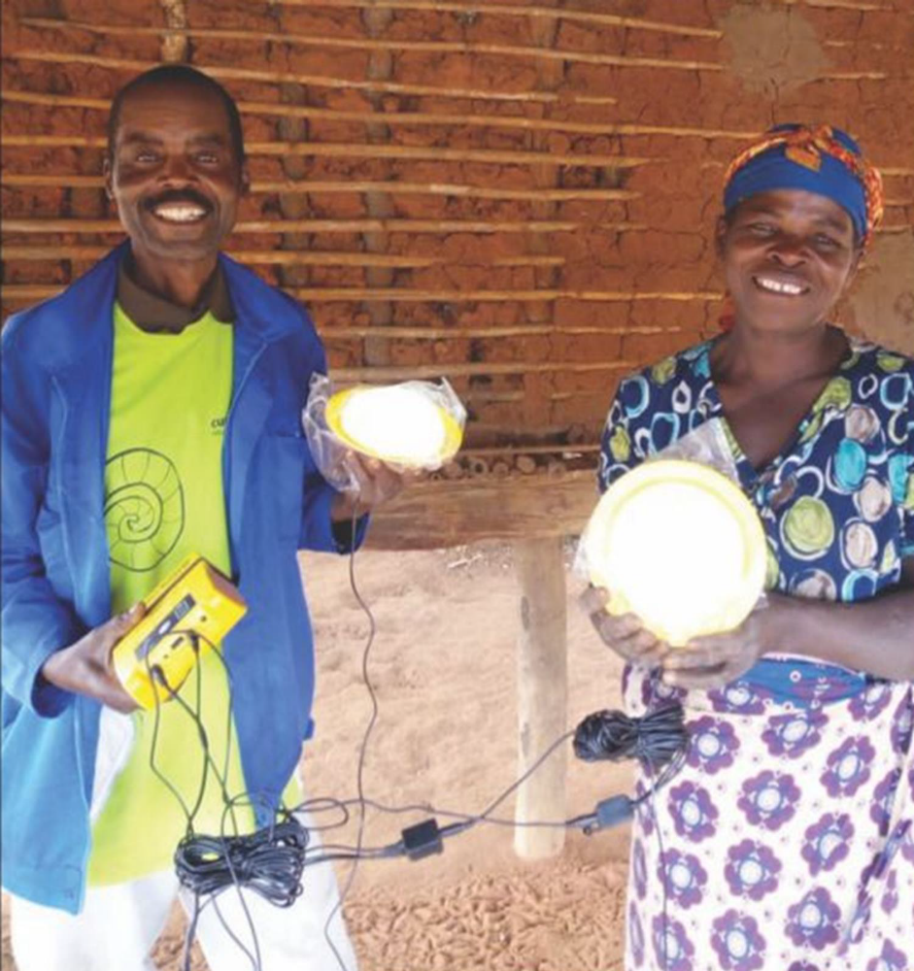
COTTON - Sociedade Algodoeira do Niassa JFS, SA
Other activities
Collect empty pesticides containers - Ecoativists;
Provision of Solar power systems for homes;
Supply products at the request of farmers at the end of the season (ex: construction materials)

Slide 6
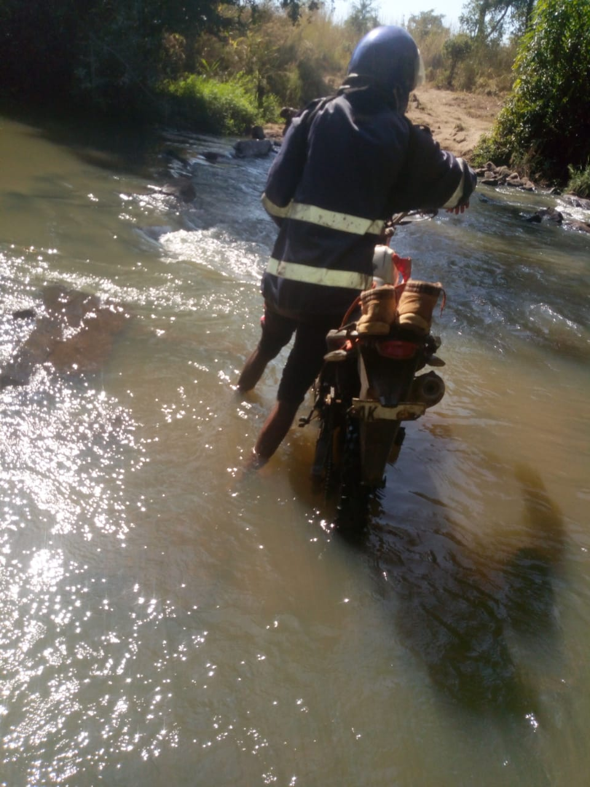
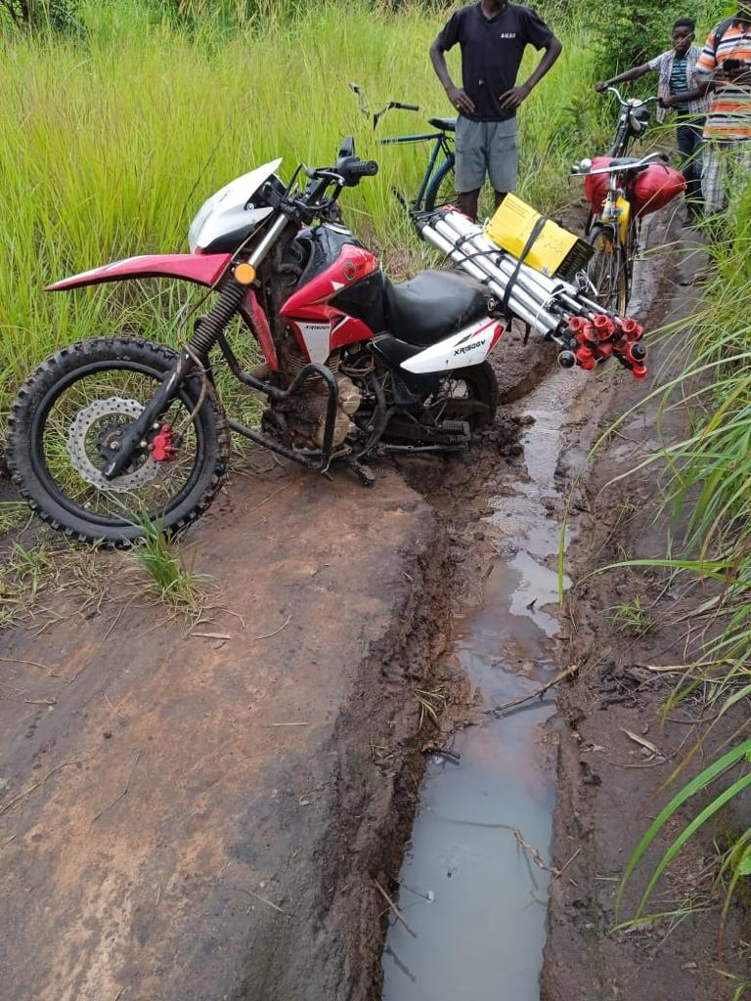
COTTON - Sociedade Algodoeira do Niassa JFS, SA
Challenges
Reaching farmers – Difficult due to the conditions of the roads;
Weak communication network in the field;
Distance between communities make difficult to assist all farmers during the season.

