Slide 1

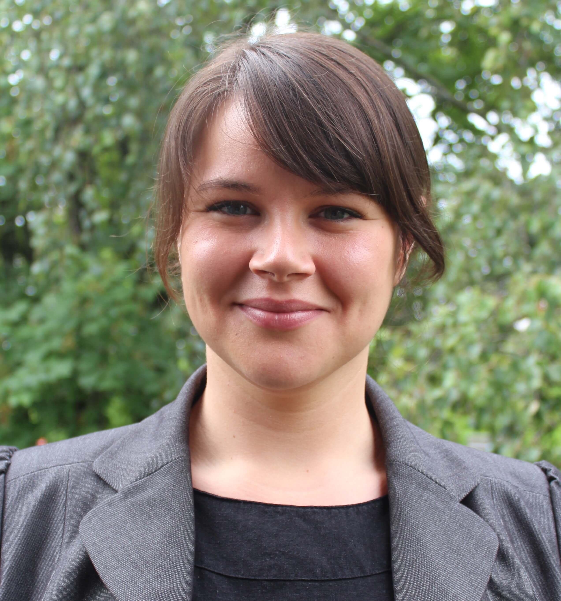
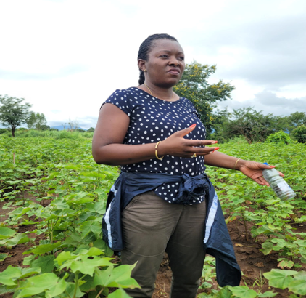



Making Carbon Finance Projects Work for Farmers
Breakout
Wednesday 21 June
With Facilitators:
With Speaker:
Laila Petrie
CEO, 2050​
Amelia Sidumo
Senior Regional Coordinator, Better Cotton​
Joyce Tsoi
Director of Collective Action Programs, Sustainable Apparel Coalition
Maria Kjaer
Smallholder Livelihoods Manager,
Better Cotton
Thomas Blackburn
Head of Business Development,
SustainCERT

Slide 2
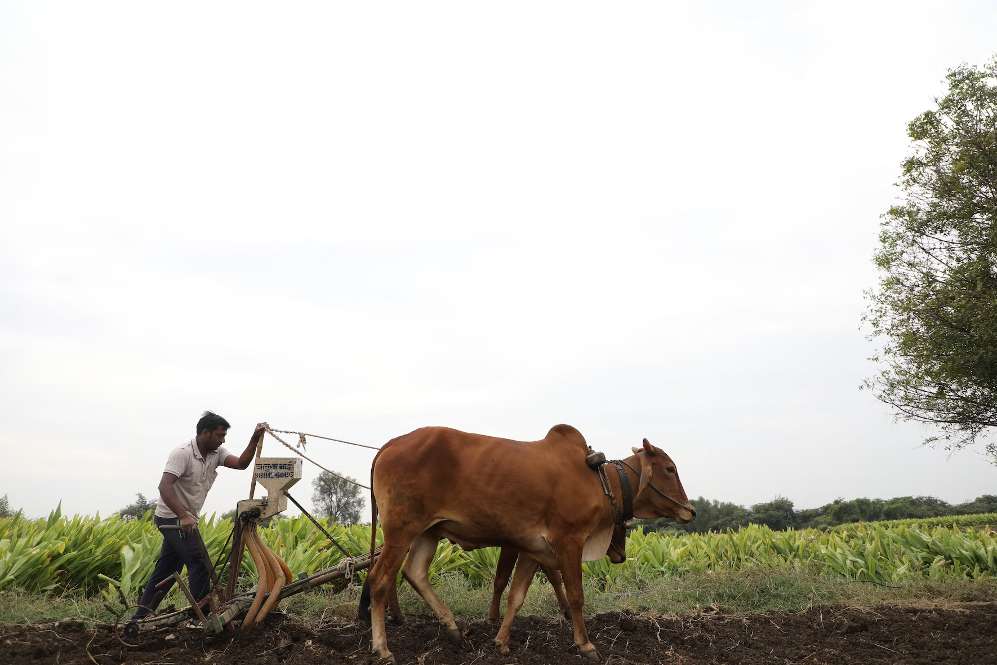

Making Carbon Finance Work for Farmers

Slide 3

Traditional climate solutions - Certification and LCAs
Certification = verifying practices
LCAs provide outcome assessments - expensive, static, limited geographies and schemes
Farmers get funding from certification, not from GHG quantification
Brands cannot make GHG claims from most certification
LCA
Brand
Certification scheme
Farmers

Slide 4
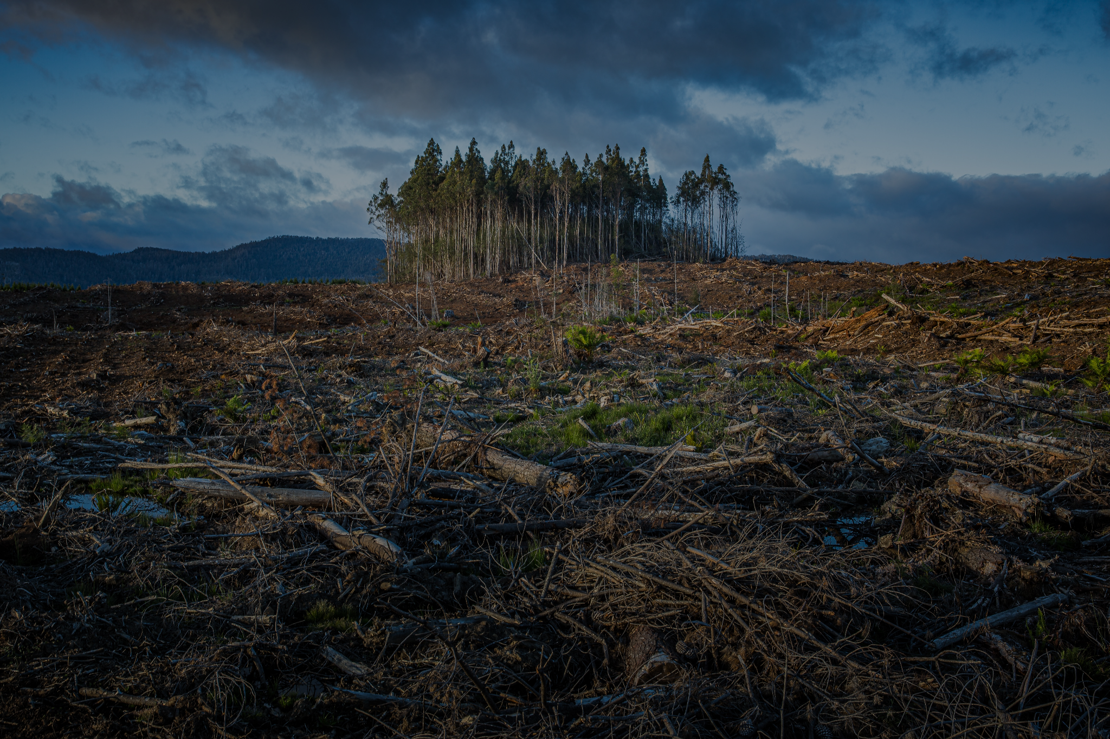
Offsets
Offset = product or company GHG claim without supply chain link
Certifies a project to a global standard of GHG measurement, allows any company to claim and pay for those GHG benefits
Offsets are not accepted for SBTi near-term targets or CDP reporting
Can be commercial and vary in quality. Project paid for GHG outcomes but the price and % of funds to them varies
Offset
Any company
Offset
Offset
Offset
Offset
Any project

Slide 5

Insetting - the new frontier
New solution for GHG accreditation within the value chain of a company
Requirements include traceability, project level measurement and verification, and alignment with guidance
Adaptation for developing countries needed
Company can claim in scope 3 if aligned with SBTi and GHGP
Farmers paid for GHG outcomes which may include pre-financing
Brand
Inset claim
Supply chain
Quantification and validation
Farmers

Slide 6

Group discussion
Different stakeholders derive different benefits from inset approaches + areas of debate
You have been assigned a stakeholder profile and will need to work in your groups to:
Review each scenario
Explore the pros and cons of these scenarios for your stakeholder type, and whether any of the scenarios are ‘deal breakers’
Decide which scenarios you prefer as your stakeholder type, and whether there are any adjustments required to overcome ‘deal breakers’
Share this back with the plenary - and then negotiate for the best deal between all the groups

Slide 7

“Reductions” - reducing conventional GHGs through efficiency, reducing chemical and fuel use
Farm
Types of GHG claim
“Removals” - locking carbon in the soil to pull it from the atmosphere through action from the plant and other natural soil processes
Soil
Soil carbon monitoring checks whether soil carbon is lost from the soil (a “reversal”). If this happens, the amount lost should be reported as an emission. Also known as “permanence monitoring”
Soil carbon monitoring
Soil
SBT conventional
FLAG target setting involves splitting land based emissions from non land based emissions
Removals targets
Industrial target
FLAG target
Removals targets sit under FLAG, and cover any removal of GHGs from atmosphere through organic means. Required for removals claims
Removals target

Slide 8
Strong traceability
Farm
Ginner
Spinner
Tier 2
Tier 1
Brand
Inset claim
Brand
The “supply shed” approach links brands to a sourcing region through country, region and functional characteristics. Any farm within that region can then be attributed to the brand and claims can be shared through insets
Supply shed traceability
Sourcing region
Farm
Farm
Farm
Farm
Farm
Farm
Before
After
“Intervention” accounting means quantifying the GHG benefits of an intervention through comparing the impacts before and after - including demonstrating that the action would not have happened if not for the entity creating the claim (“causality”). This difference is then applied to a company’s accounting
Intervention accounting
Farm baseline
Intervention
Outcome
Causality
After
“Inventory” accounting drops causality to focus on the final outcome at site level. This is then compared to the company’s own inventory baseline to show the difference. The choice of baseline is v important
Company baseline
Inventory accounting
Intervention
Outcome

Slide 9
 | Scenario 1 | Scenario 2 | Scenario 3
Scope | GHG reductions and soil carbon | GHG reductions | GHG reductions and soil carbon
Data | Complex data from smallholders | Complex data from smallholders | Adaptive approach for smallholders
Traceability | Strong traceability | Supply shed approach | Supply shed approach increasing over time
Soil carbon monitoring | Permanence monitoring forever + liabilities for farmers/brands | No soil carbon so no monitoring | Pared back monitoring + insurance mechanism for reversals
Accounting approach | Inventory accounting - farmer performance against global baseline | Intervention accounting - before and after with strong causality | Inventory accounting - farmer performance against a local baseline
Targets required | ‘Removals’ targets required to claim soil carbon | Can’t claim soil carbon so no targets needed | ‘Removals’ targets required to claim soil carbon
Funding | High funding requirements | Low funding requirements | Fairly low funding requirements
Validation | Aligned with soil carbon guidance | Aligned with reductions guidance | Not in line with existing guidance

Slide 10


Making Carbon Finance Projects Work for Farmers
Breakout
You can find a breakdown of the various Workshop scenarios by scanning the QR CODE below-
Online participants, please join the Zoom link provided in the chat.

Slide 11
 | Scenario 1 | Scenario 2 | Scenario 3
Scope | GHG reductions and soil carbon | GHG reductions | GHG reductions and soil carbon
Data | Complex data from smallholders | Complex data from smallholders | Adaptive approach for smallholders
Traceability | Strong traceability | Supply shed approach | Supply shed approach increasing over time
Soil carbon monitoring | Permanence monitoring forever + liabilities for farmers/brands | No soil carbon so no monitoring | Pared back monitoring + insurance mechanism for reversals
Accounting approach | Inventory accounting - farmer performance against global baseline | Intervention accounting - before and after with strong causality | Inventory accounting - farmer performance against a local baseline
Targets required | ‘Removals’ targets required to claim soil carbon | Can’t claim soil carbon so no targets needed | ‘Removals’ targets required to claim soil carbon
Funding | High funding requirements | Low funding requirements | Fairly low funding requirements
Validation | Aligned with soil carbon guidance | Aligned with reductions guidance | Not in line with existing guidance

Slide 12



Closing remarks
Please join us back in the plenary room
Room: Concertzaal

