Slide 1

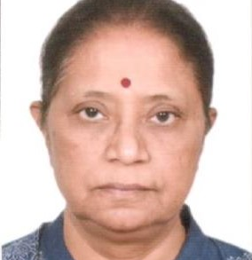
Communities’ Wellbeing and Sustainable Livelihoods
Plenary
Wednesday 21 June
With Speaker:
Jyoti Macwan
Secretary-General, SEWA​

Slide 2


WELLBEING AND SUSTAINABLE
LiveliHOODS
Jyoti Macwan, Secretary-General Self-Employed Women’s Association (SEWA)
Better Cotton Conference

Slide 3
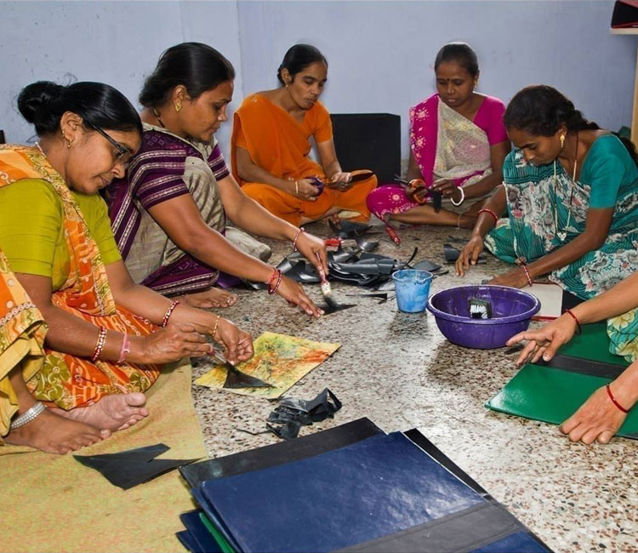

About Us
Established in 1972 as a trade union, SEWA has grown to become a member-based organisation of more than 2.5 million women
.
Founded in Ahmedabad, Gujarat
Need-based and demand-driven approach
Over 50% of members from agriculture
Support workers to advance careers
Provide access to healthcare, childcare, insurance, housing and legal services
Notes:
Is a member-based organization of over 2.5 million poor self-employed women workers from informal economy.​
Objectives are Full-Employment and Self-Reliance​
Established as a Trade Union in 1972 by Late Shri. Elaben Bhatt​
Members come from 18 states of India and over 125 trade unions
Over 2/3rd of SEWA’s membership is Rural ​
Over 50% are from Agriculture.​
Need-based and demand-driven Approach​
Joint Strategy of Struggle and Development

Slide 4
Our APPROACH
SEWA adopts a holistic and integrated approach…
Capacity Building
Organising
Social Protection
Capital Formation
“Poverty is a form of violence perpetuated by the consent of society”​
Notes:
SEWA strongly believes that “Poverty is a form of violence perpetuated by the consent of Society”​
Therefore, to enable wellbeing of its member through economic empowerment, we come together as Poor, as Women and as Workers to fight against Poverty.​
SEWA adopts a holistic and integrated approach of​
Organizing: is the key. It helps build collective strength and bargaining power. It also brings voice, visibility and Validity to women as workers​
Capacity Building: To upskill, re-skill and diversify the existing skills of women to help them stand firm in the competitive markets​
Capital Formation: Asset creation is the surest way to Fight Poverty. Therefore, organizing women into their own SHGs / economic organizations​
Social Protection: Access to basic support services healthcare, childcare, insurance, housing, and legal services. ​

Slide 5
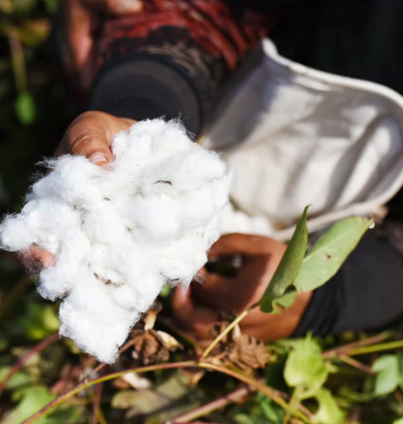
Image SLide
WOMEN NEED WORK NOT CHARITY
Notes:
Our Experience working with poor women over the past 5 decades has shown that Women do not need Charity​
They need work… Work that provides a steady source of income and asset ownership can break one’s fall into the vicious circle of poverty and in indebtedness.​
Therefore, SEWA has organized members based on their skills into their own collectives, cooperatives, federations, producer companies and micro-enterprises economic organizations.​
Till date, SEWA has built a family of over 4000 SHG’s, 120 cooperatives, 15 federations and 3 producer companies – all owned and managed by workers themselves.

Slide 6
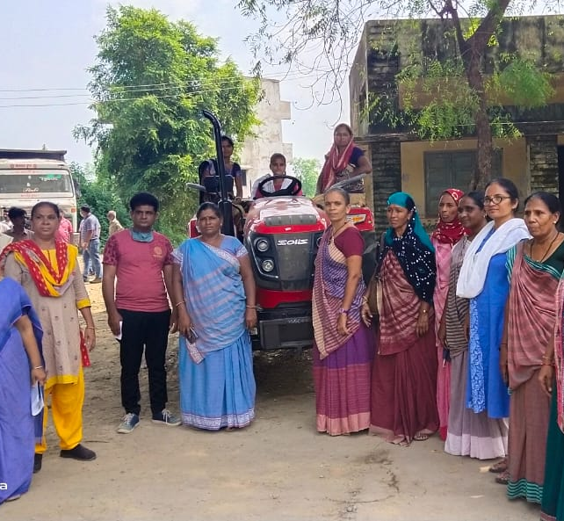



Social enterprises
SEWA supports women’s wellbeing through social enterprises.
Notes:
Enabling Poor Women’s Wellbeing through SEWA’s Social Enterprises​
Owned and managed by the members themselves – Members themselves are the shareholders. ​
Non-political, democratically functioning, often based on trusteeship. ​
Strengthen the livelihoods of its members ​
Increases their collective bargaining strength​
Broadens access to market​
Generate an array of employment opportunities for more women workers like them. ​
hybrid goals like capacity building and advocacy​
Hansiba - From Every Rupee spent at Hansiba, 60 Paisa goes directly to the Artisan
Kamla - Every meal at Kamla provides livelihood to 6 poor families
Final - Brings food and nutrition security to a million poor rural households.
Towards Sustainable Wellbeing – Addressing Socio-Cultural Norms through Social Enterprises
SEWA’s member-owned Social enterprises​
​
Apply commercial strategies to facilitate improvements in financial, social and environmental aspects of the members lives and livelihoods​
Lead to an increase in number of educated girls in the families and villages of our first / second generation members​.
Increased respect for women in the household, Community and Society​
Increased negotiating power of SEWA’s members in their homes, workplaces as well as community​
Increased assets in the name of women​
Reduction in rural out-migration. Thus, SEWA’s coops or enterprises have multiple bottom line.

Slide 7
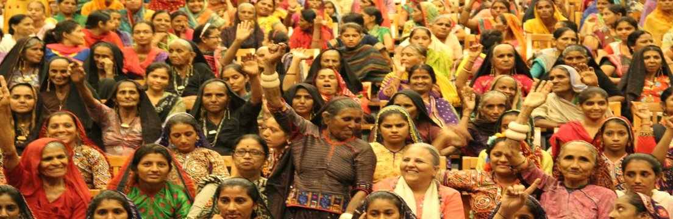


THANK YOU
Jyoti Macwan
JyotiMacwan@Sewa.org
https:www.sewa.org

